Slide 1

Measures of Position for Ungrouped Data
a presentation by Leah

Slide 2

Agenda
3 | Introduction
5 | QUARTILES
6 | decILES
7 | PERCENTILES
8 | APPLICATION OF MEASURES OF POSITION
9 | CHOOSING THE RIGHT MEASURE
10 | CONCLUSION

Slide 3

Why are they important?
Provide insights into the distribution of data.
Allow for comparisons between different datasets.
Enhance data analysis and interpretation.

Slide 4

INTRODUCTION
What are measures of position?
Numerical values that describe the location of data points within a set.
Help us understand how individual data points relate to the rest of the data.

Slide 5
QUARTILES
Divide the data set into four equal parts.
Q1 (First quartile): 25% of the data points fall below this value.
1
2
Q2 (Second quartile) or Median: 50% of the data points fall below this value, marking the middle of the data set.
Q3 (Third quartile): 75% of the data points fall below this value.
Image 1: A box plot illustrating quartiles and the interquartile range (IQR).
3
4

Slide 6
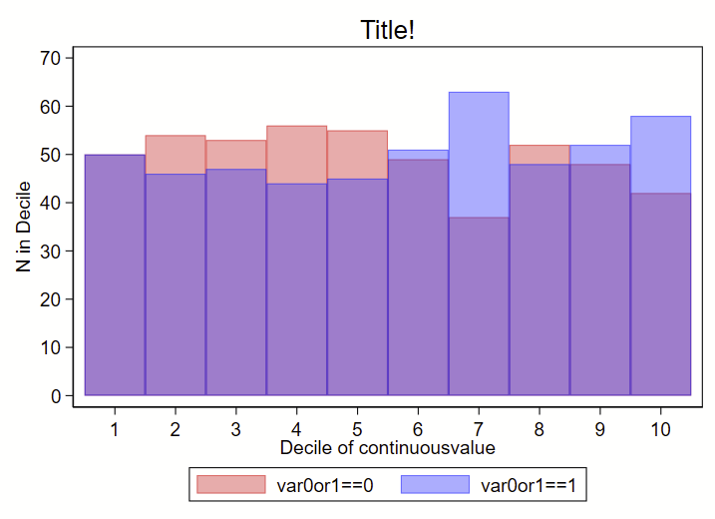
DECILES
Divide the data set into ten equal parts.
D1 (First decile): 10% of the data points fall below this value.
1
2
D5 (Fifth decile): 50% of the data points fall below this value.
D9 (Ninth decile): 90% of the data points fall below this value.
A histogram with decile marks overlaid.
3
4

Slide 7
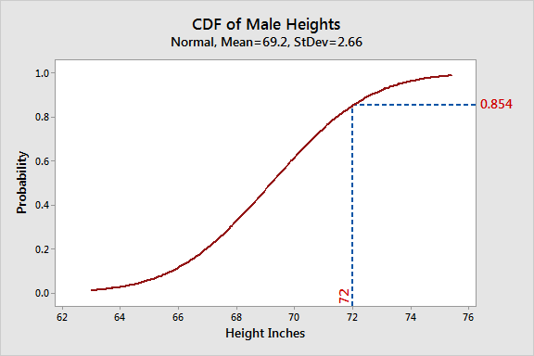
percentiles
Divide the data set into 100 equal parts.
P25: 25% of the data points fall below this value.
1
2
P50: 50% of the data points fall below this value (same as the median).
P75: 75% of the data points fall below this value (same as Q3).
A cumulative distribution function (CDF) showcasing percentiles.
3
4

Slide 8



Applications
Analyzing exam scores
Comparing income levels
Studying environmental data
Identifying the percentage of students below or above certain benchmarks.
Determining the median income and decile ranges within a population.
Tracking changes in air quality percentiles over time.
Measures of position

Slide 9
Choosing the Right Measure The choice depends on the level of detail needed and the research question.
provide a basic overview of the data distribution.
quartiles
offer a finer-grained analysis with ten cut-off points.
deciles
offer the most granular analysis with 100 cut-off points.
percentiles

Slide 10
conclusion
Measures of position are valuable tools for understanding data distribution.
By calculating quartiles, deciles, and percentiles, we gain insights into where data points lie within a set.
These insights can inform decision-making, research, and data-driven storytelling.

Slide 11
THANK YOU!

